Slide 1
Inorder Traversal
1.)traverse left subtree of R in inorder
2.)traverse root R
3.)traverse right subtree of R in inorder.

Slide 2
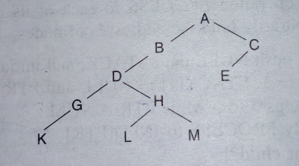
Example

Slide 3
1.)Stack:=null and set PTR:=A
2.)Proceed the left most part rooted at A, by pushing A,B,D,G and K into stack.
Stack:=null,A,B,D,G,K
No other node is processed since K has no left child.
3.)[Backtracking]Pop:=K,G and D. and Processed:=K,G,D.
Stop processing at D, as it is having right child.
PTR:=H

Slide 4
4.)Proceed down the left most part rooted at PTR:=H, pushing H and L onto stack.
Stack:=null,A,B,H,L.
5.)[Backtracking]Pop:=L,H and process:=L,H.
Stack:=null,A,B.
Stop processing at H because it is having right child M. And set PTR:=M.
6.)Proceed down the left most part rooted at PTR:=M,pushing M onto stack.
Stack:=null,A,B,M.
No other node is processed since M has no left child.

Slide 5
7.)[Backtracking]Pop:=M,B,A and process:=M,B,A
Stack:=null
We stop processing at A because it is having right child and set PTR:=C.
8.)Proceed the left most part rooted at PTR:=C, pushing C and E onto stack.
Stack:=null,C,E.
No other node is processed because E is having no left child.
9.)[Backtracking]Pop:=E,C,null and process:=E,C,null. Since C has no right child, null is popped and processed.

Slide 6
Solution:=K,G,D,L,H,M,B,A,E,C.

